Slide 1
Vending Machine Program
Andrew Littleton

Slide 2
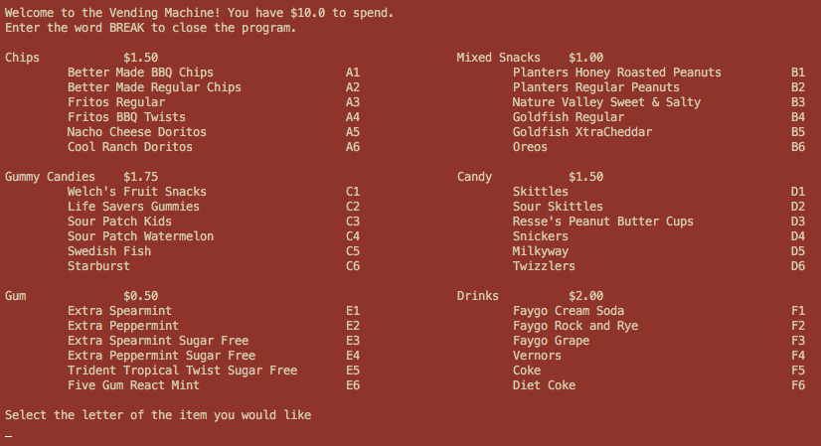
Intended Use of the Vending Machine
Program is used to provide items to user
Procedure:
Command line will tell the user how much money they have to spend and present the list of items
It will then ask for the letter and number of the item they would like
Once they have selected the item, the program will provide them the item and subtract the price of the item from the initial amount of money or their remaining balance
Main User Interface

Slide 3
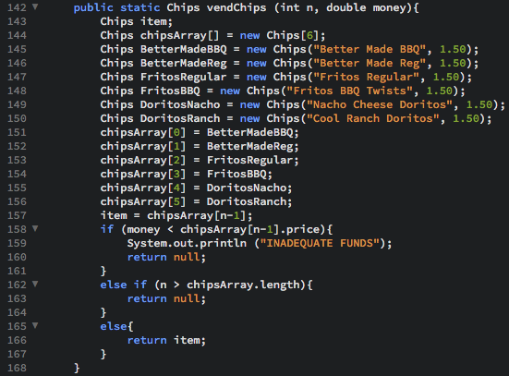
Object Oriented Structure
Utilizes Classes for each kind of item
Different Objects are used as instances of each Class
6 Classes for each row of the vending machine
6 instantiated objects from each class to define items on each row
Example:
“Better Made BBQ Chips” is the instantiation of Class “Chips”
Chips BetterMadeBBQ = new Chips("Better Made BBQ", 1.50);
”Vernors” is the instantiation of the Class “Drinks”
Drinks Vernors = new Drinks("Vernors", 2.00);

Slide 4
How the machine vends items
After the user enters a letter corresponding to a type of item (A in this example), the program will:
Ask for the number of the item to send to the vendChips method as a parameter
The vendChips method will take the n – 1 parameter and use that as the position in the item’s array that will be returned
The vendChips method:
Declares and instantiates all the objects (items) to be used in the machine
Declares the array to store the objects (items)
Checks to see if the item number to user entered is within the length of the array
Checks to see if the user has enough money to buy the item from the called method
Returns the item the user requested from the aforementioned array
The conditional in main:
Prints the item from the called method
Subtracts the price of the returned item from the money (the remaining money after multiple loops)
Prints the amount of money left

Slide 5
Update History
11/27: User Menu done and prompt set, Classes and Objects created
11/29: Completed a test ”vendItem” method to confirm procedure worked
12/2: Program compiles and runs with minor bugs
12/4: Program completed to work as intended (Vends item, lowers amount of money, and breaks once the remaining balance is below $0.50)
12/5: Added small features to enhance and make program more realistic:
Balance checker in methods to prevent negative balance
Methods check to see if user entered value that is larger than the size of array and reports if it is

Slide 6
Bugs
Items at end of the array list threw out of bounds exception
After checking for insufficient funds to buy an item, program throws nullPointerException
Certain lines are showing extra tabs on different computers
Methods, other than vendChips, returned null when called
Switched variable names in constructor in the other classes to fix problem
Printed item list needed to be corrected to line up
Modified the number of tabs between each printed word
Objects being created in methods weren’t having names and prices declared
Changed lines to standard object declaration

